Slide 1

Perception for Autonomous Vehicles
Nicolò Parisi

Slide 2

LANE DETECTION
Process of identifying and tracking road lane markings in real-time
Goal: Enhances safety and navigation in advanced driver-assistance systems (ADAS)
Utilizes images streams captured by onboard cameras or sensors
Generates a clear representation of lane positions to guide vehicle control.
Challenges: Works under varying lighting, weather conditions, and occlusions
Applications: Lane keeping, automated lane changes, and collision avoidance systems.

Slide 3
MODELS TYPE
Top-down
- Global understanding of the road scene.
- High-level contextual information to predict lane positions.
- Pre-trained models
Bottom-up
- Processing of pixel-level details
- Detecting small-scale features such as edges, colors
- Edge detectors, pixel gradient calculus, statistical distribution

Slide 4
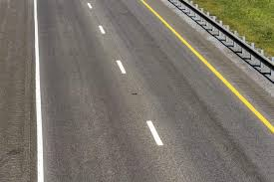

CANNY EDGE DETECTOR
What is an edge?
Significant and sharp change in the intensity or brightness of an image
4 steps:

Slide 5
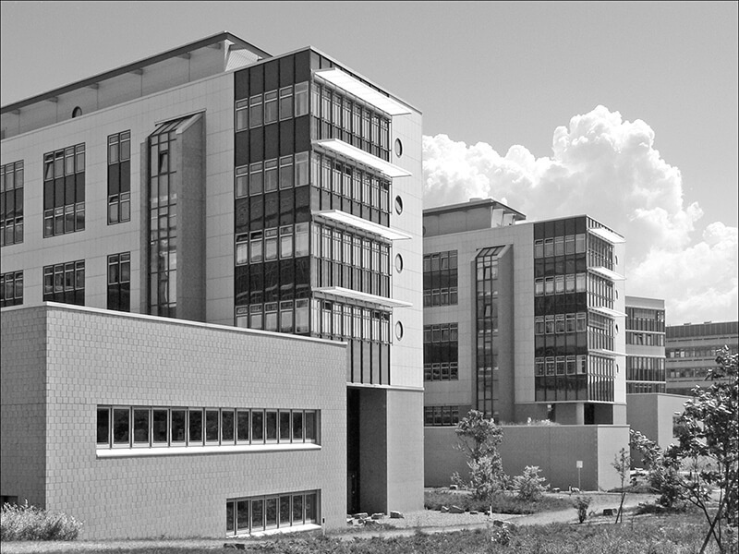
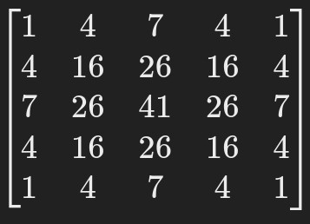

DENOISING
Gaussian filter
Noise in images can cause sudden intensity changes
Smooth intensity gradient changes
σ increase the the blur

Slide 6
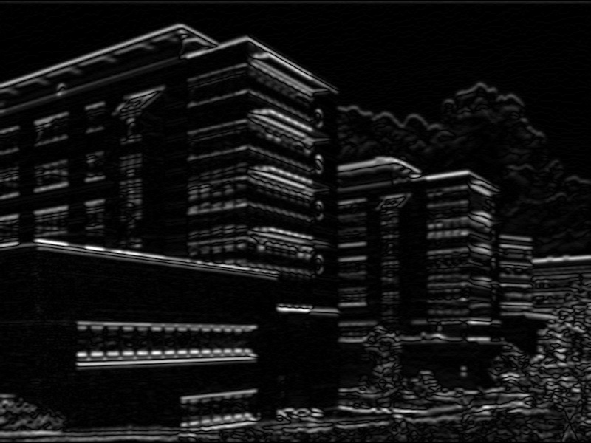
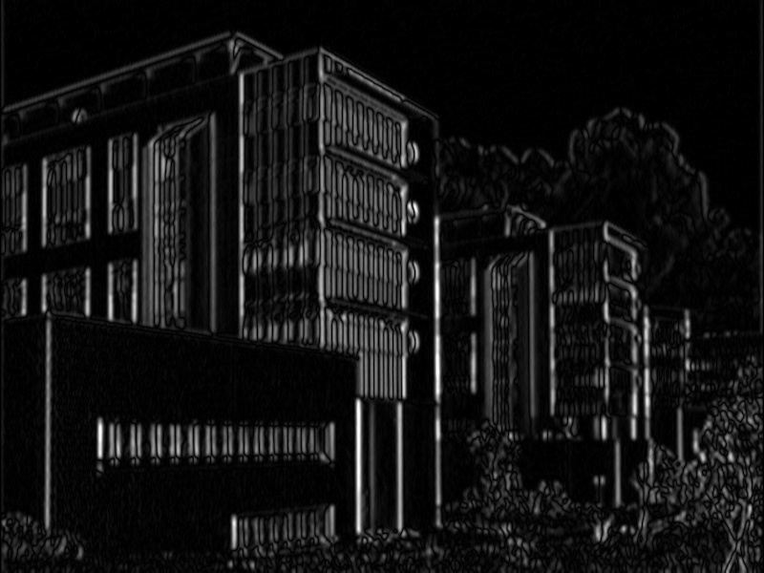
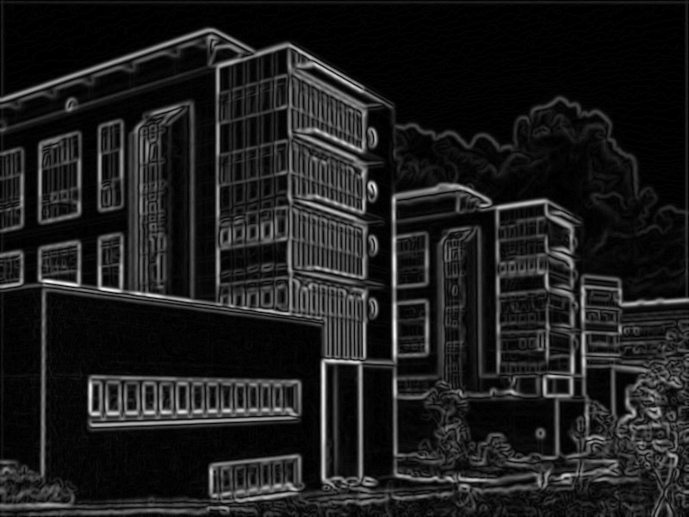
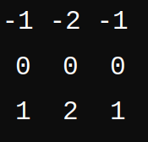

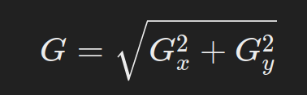
GRADIENT COMPUTATION
- SOBEL ALGORITHM
- convolutional filters
- magnitude of the gradients
- rotation of the edges

Slide 7
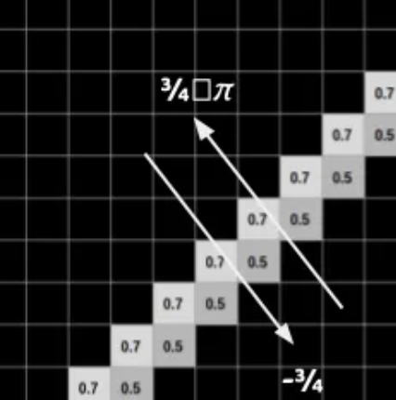
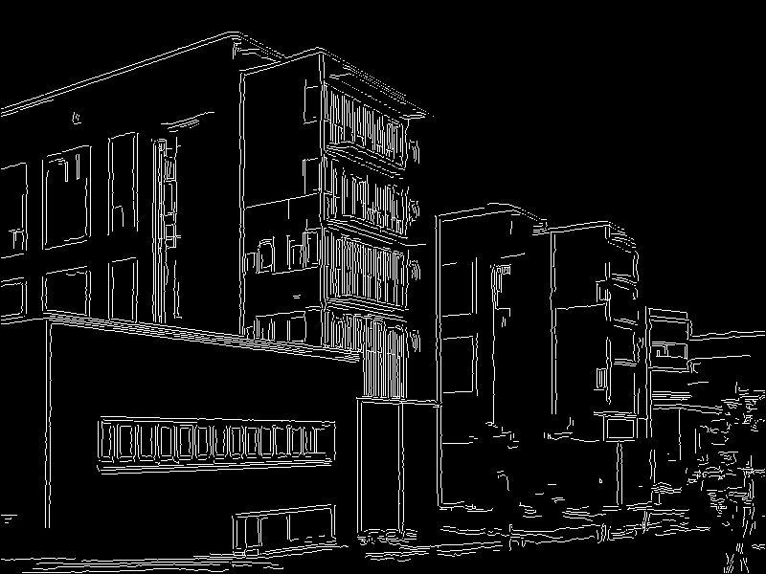
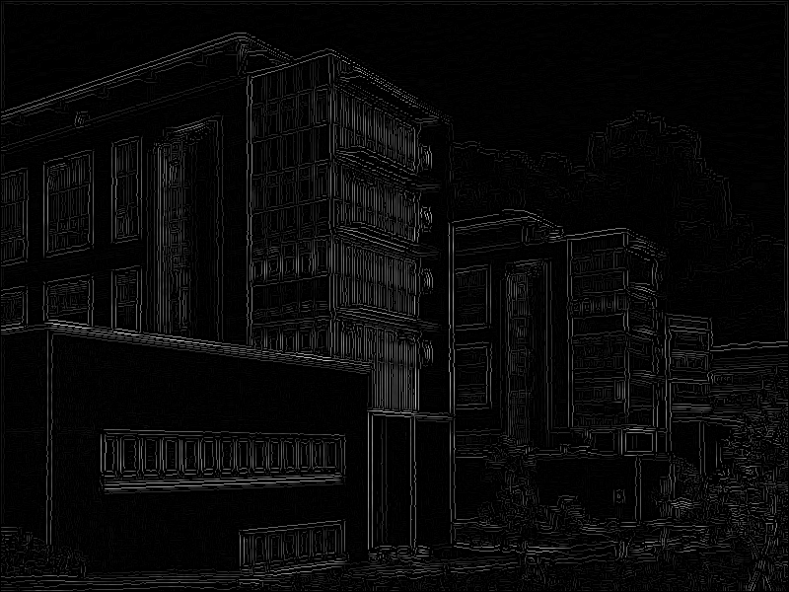
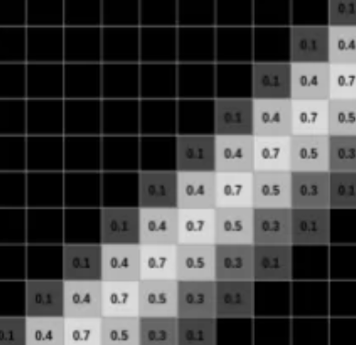
NMS
Pixel with non maximum value in the direction of the edge are discarded.
This produce thinner and more accurate edges

Slide 8
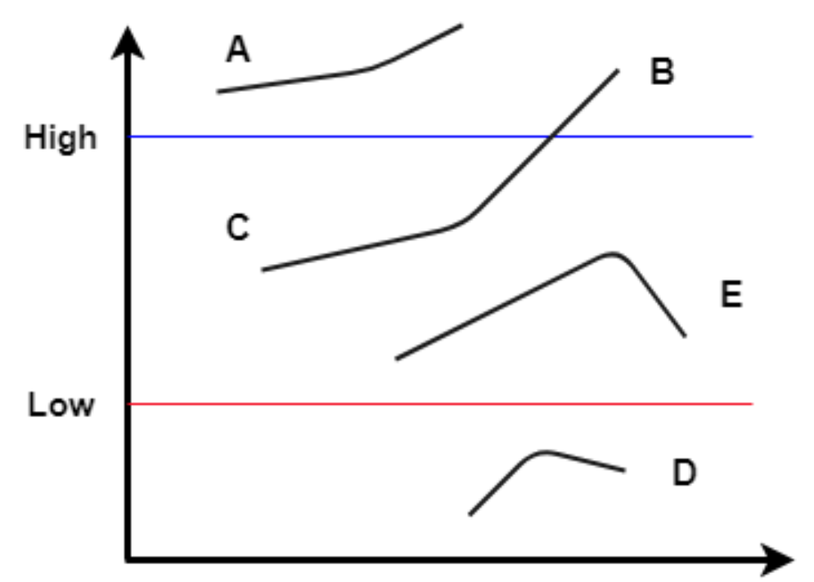
DOUBLE THRESHOLDING
- Define two thresholds
- strong edge: gradient magnitude above the high threshold -> just retained
- Non-edge: gradient magnitude below the low threshold -> simply discard
- Weak edge: gradient magnitude between the high and low threshold -> conditionally retained if connected to a strong edge
A: strong B: strong C: weak (promoted) E: weak (discard) D: non edge

Slide 9
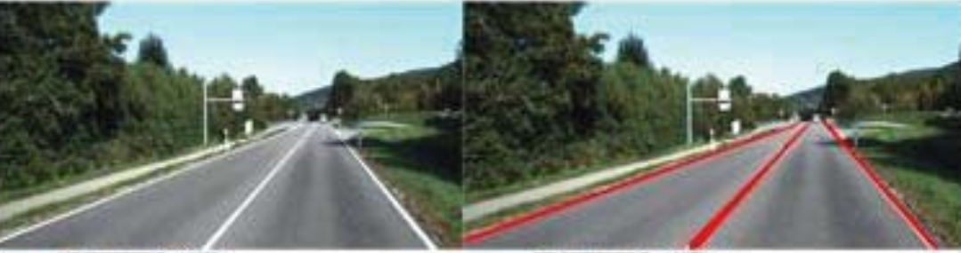
HOUGH TRANSFORM
Algorithm introduced 1962 to identify simple shapes in binary images such as:
- lines
- circles
takes in input the output of an edge detector
fills the gaps between them if they exist

Slide 10
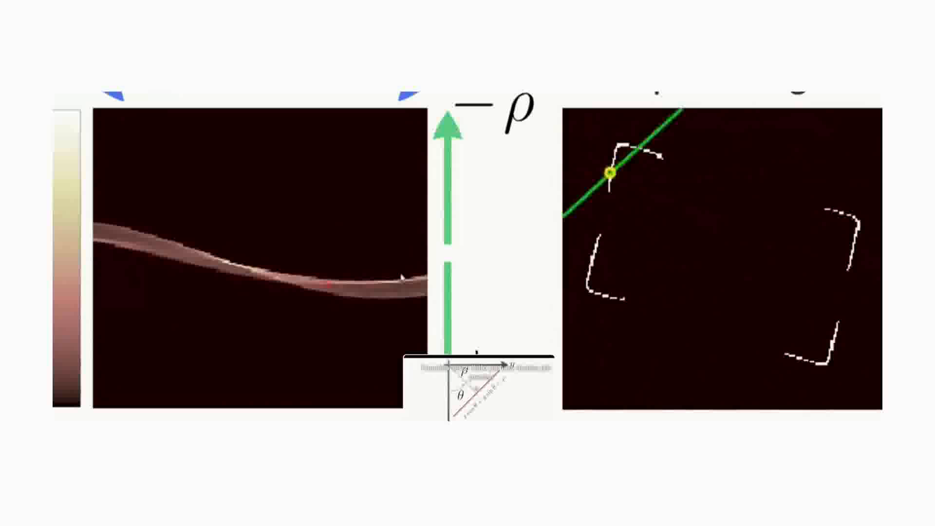
HOUGH TRANSFORM LINES
- Parsing of each pixels of the image
- Line representation:
p = x cos(θ) + y sin(θ)
- Accumulation space

Slide 11
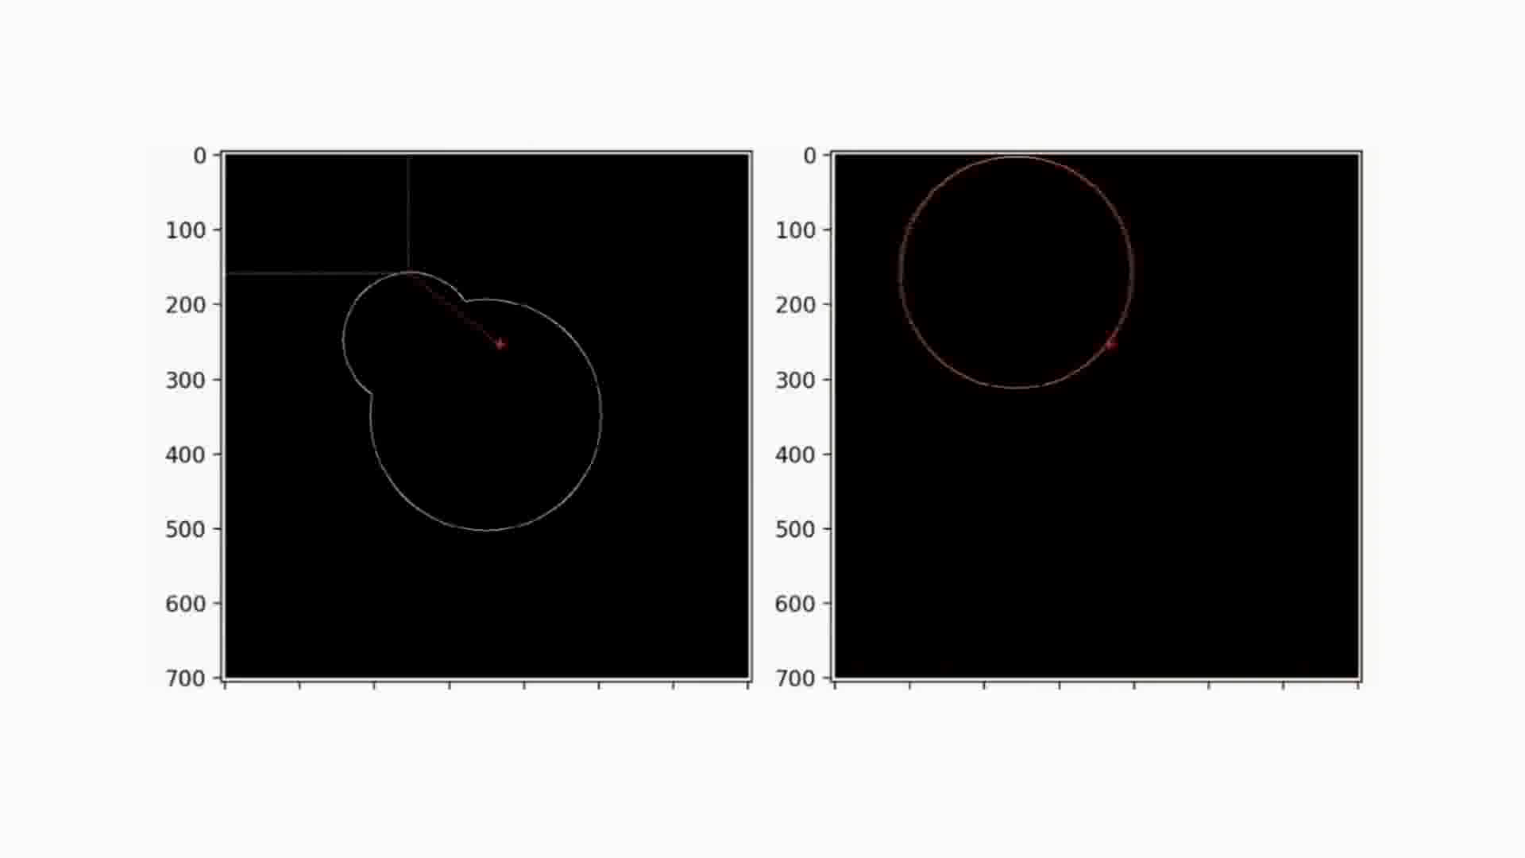
HOUGH TRANSFORM CIRCLES
- Parsing of each pixels of the image
- For each point on the edges, a circle is drawn with a given radius
- Accumulation space

Slide 12
HOUGH TRANSFORM PARAMETERS
LINES
- p/θ: resolution of the accumulator.
- Threshold: The minimum number of intersections required to consider a line as detected.
- Min/Max line length: The minimum and maximum length of a line seg-
ment required to be considered a valid line.
CIRCLES
- Max/min Radius: The smallest/largest radius value that the algorithm will consider when searching for circular structures
- Threshold: The minimum number of intersections required to consider a circle as detected

Slide 13
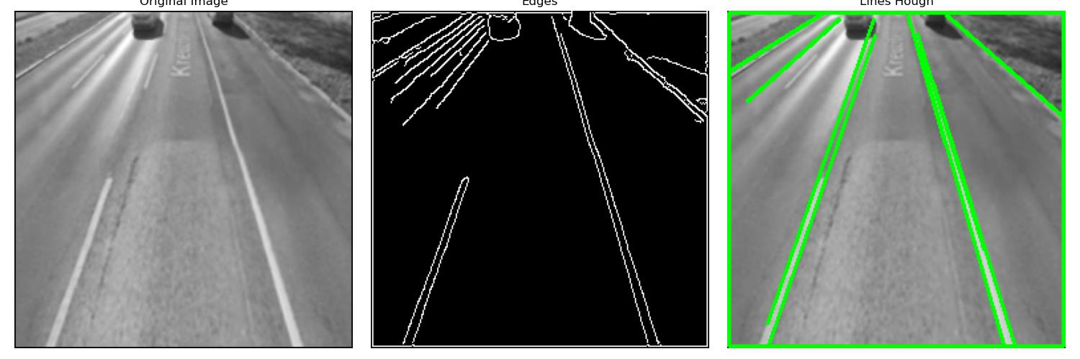
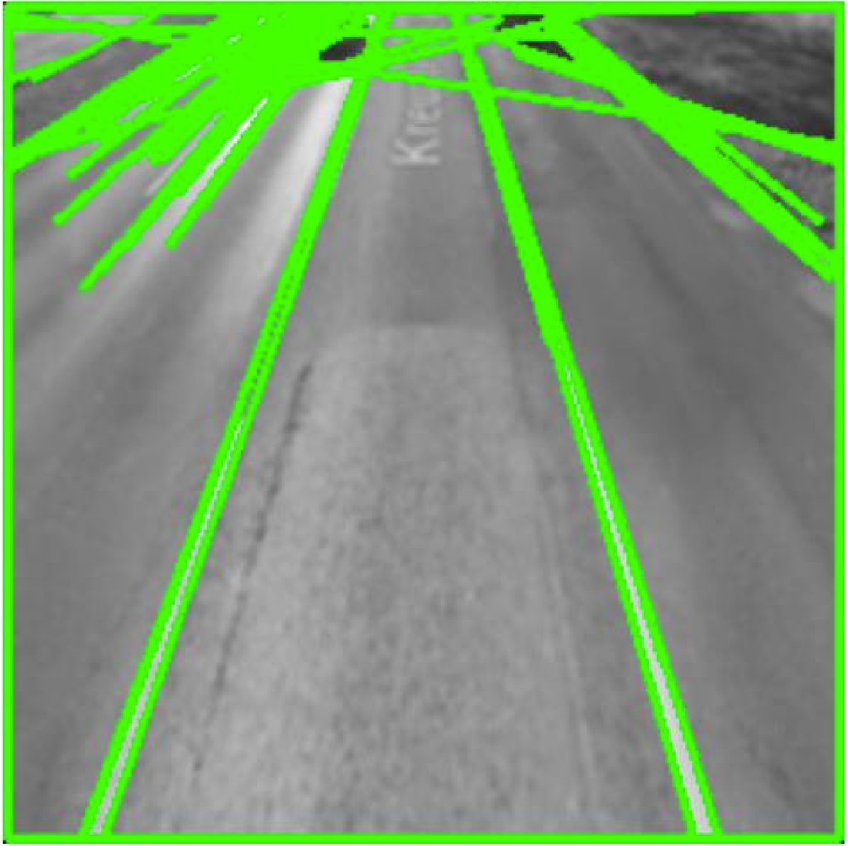
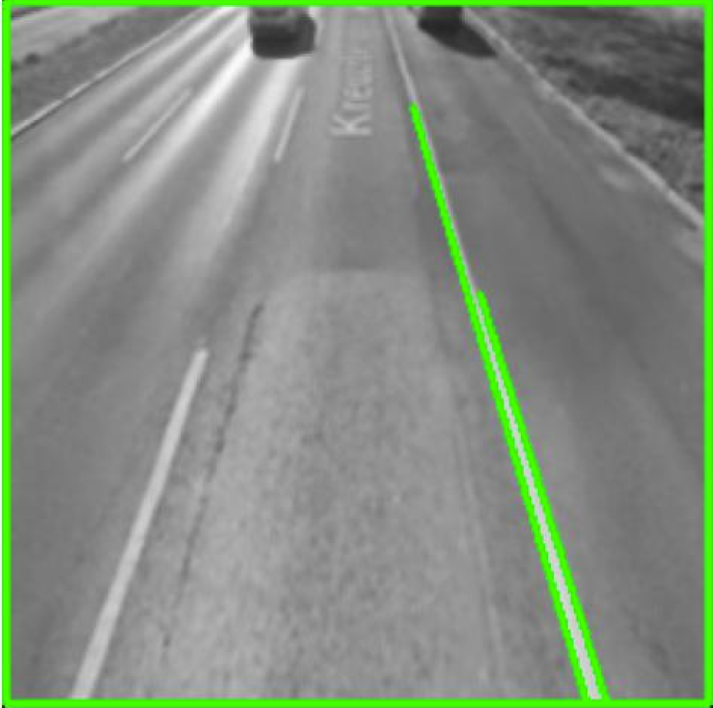
HOUGH TRANSFORM EASY TO MESS UP
What we expect:
What we can get:

Slide 14
PRACTICAL APPLICATION Real-Time Lane Detection and Tracking for Advanced DriverAssistance Systems
Fuzzy Noise Reduction Filter (FNRF)
(ROI) image segmentation
Canny Edge Detector
Hough transform
Tracking mechanism ensures continuity across video frames.

Slide 15
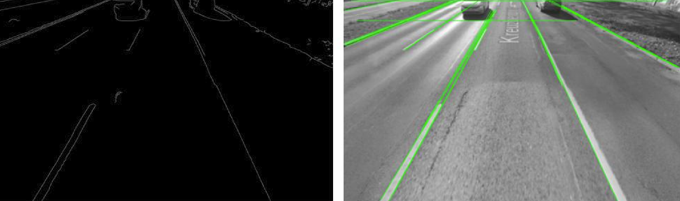
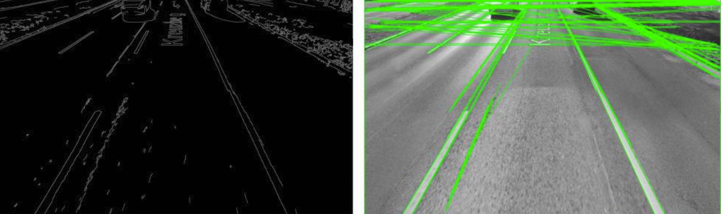
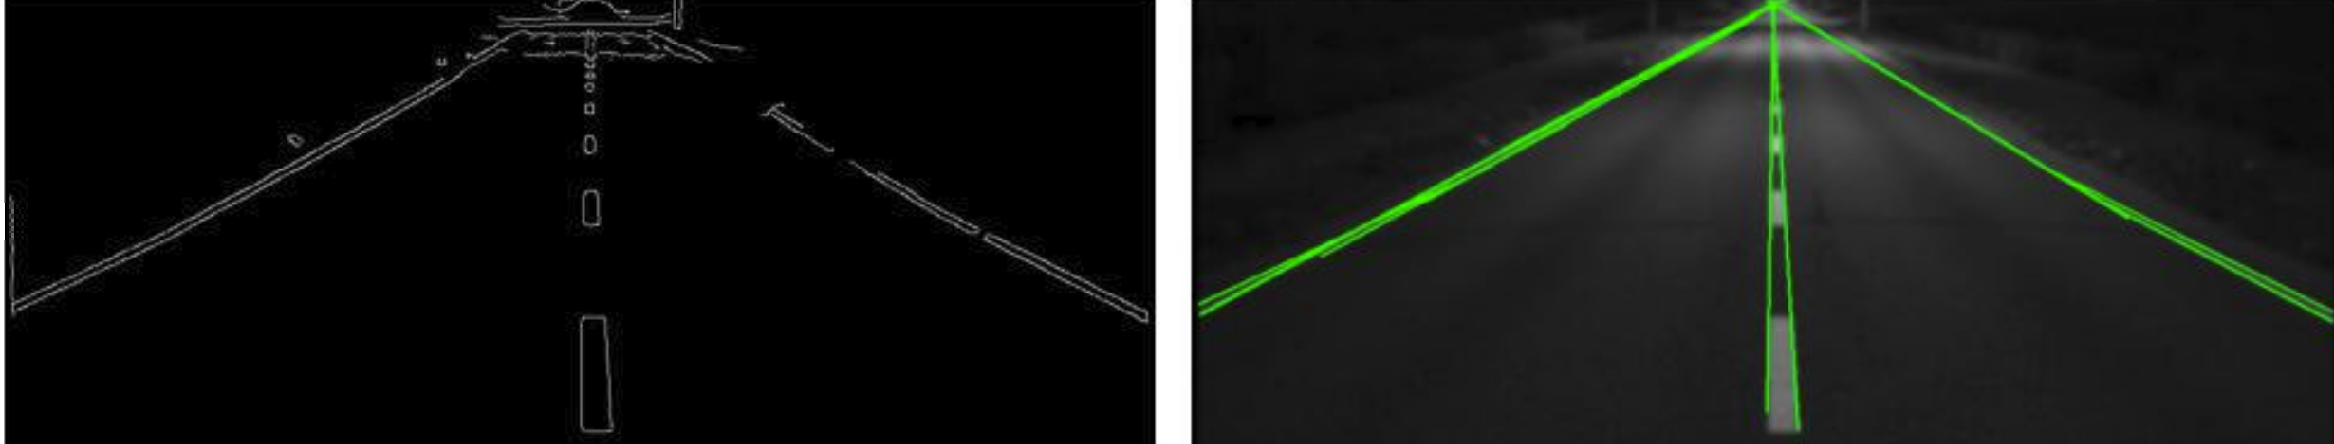
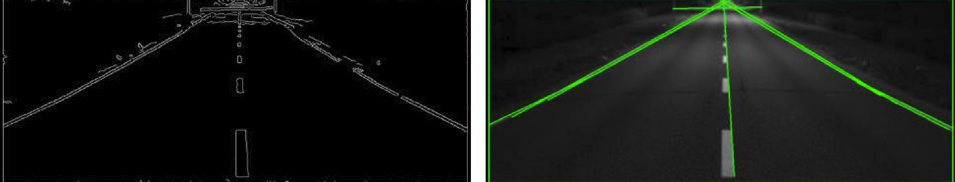
PAIN POINT Reliability / Consistency
Gaussian filter
Fnrf filter

Slide 16
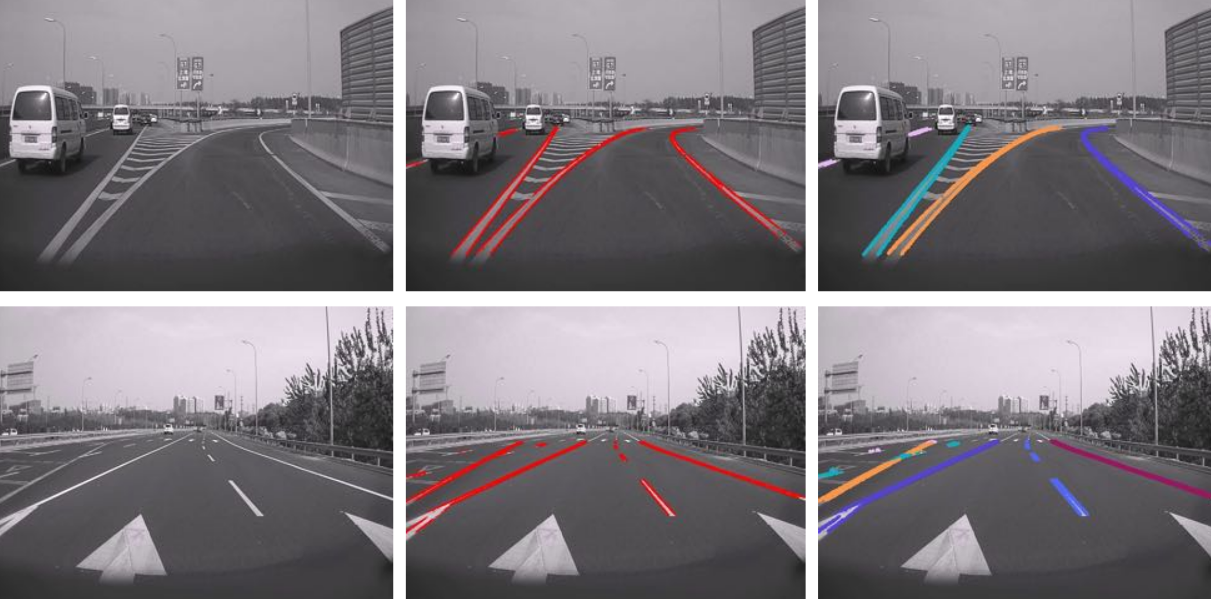
NEXT STEPS
Deep learning
- No assumptions
- More generalizable
- More robust
LANE NET
Lane edge proposal network: input image output lane edge proposal map.
Lane line localization network: inferring the location of each lane in the image from edge proposal map

Slide 17
Thank YOU
Nicolò Parisi

